Slide 1

SKINCARE RECOMMENDER SYSTEM
By: Kira Wong

Slide 2
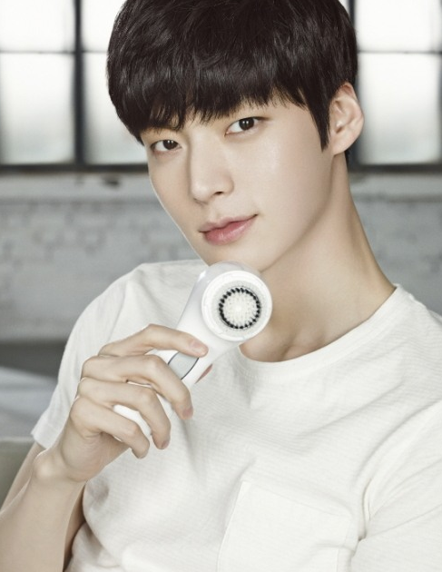
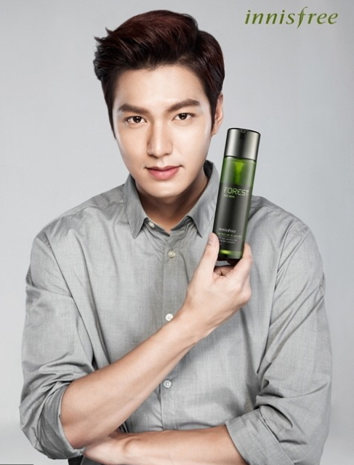
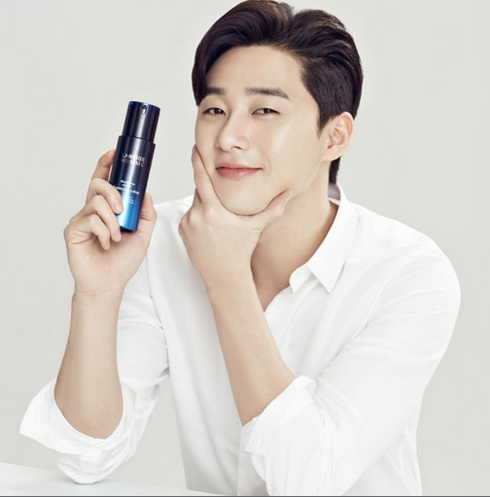
OBJECTIVE
Korean wave increased awareness of skin care for men
Vast options of skincare products in the market
Provide an easy & lazy way to purchase similar products

Slide 3


METHODOLOGY
NLP
Dimension reduction
Web Scrape
Pre-processing
EDA
Model

Slide 4
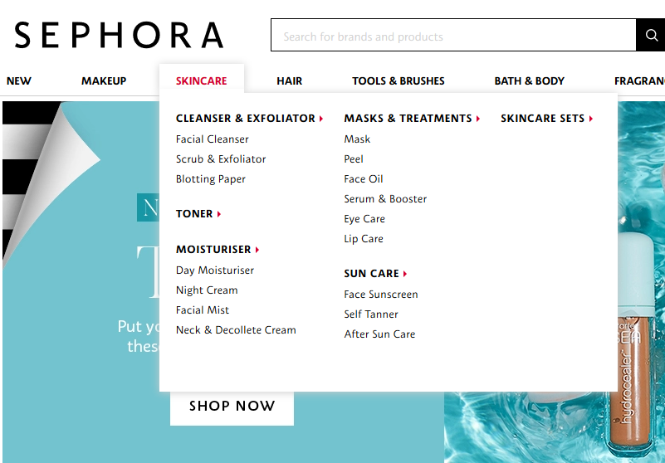
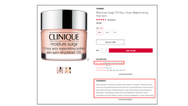
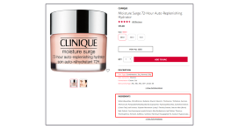
DATASET
Webscraped using Selenium
Skincare related category

Slide 5
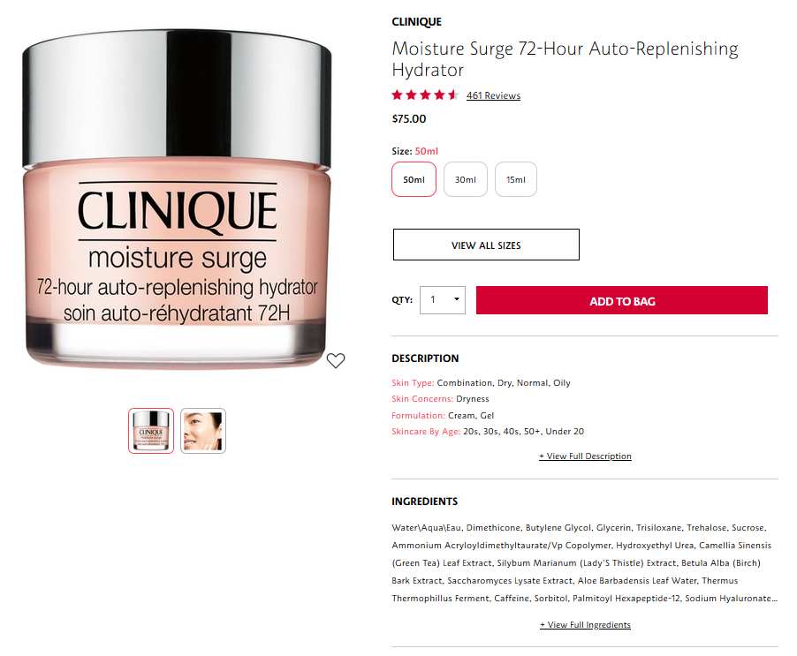

Slide 6
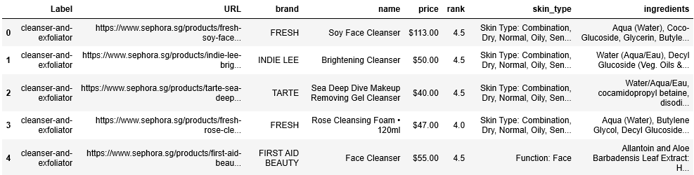
Big concept
Skin type & ingredients requires further cleaning & pre-processing

Slide 7
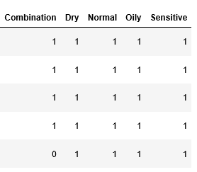
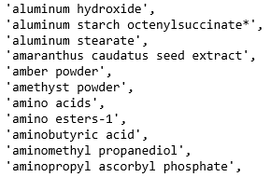
PRE-PROCESSING
Dummy variables
(skin type)
Count vectorizer
(ingredients)
Lower-case
Tokenize

Slide 8
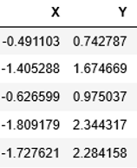

MODEL
Category
Skin type
COSINE
SIMILARITY
FILTER:
T-SNE

Slide 9
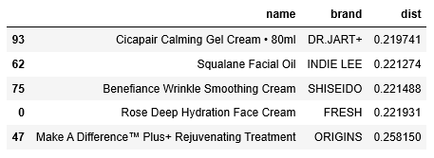
RESULTS
User input:
What is my skin type? Dry
What category am I looking for? Moisturiser
Name of product I am familiar/like/use before? Benefiance Wrinkle Smoothing Cream
Model recommends:
5 closest similar products

Slide 10
CONCLUSION
Model testing in the market to evaluate
Developing a good recommender system may help skincare companies break into un-tapped market

Slide 11
FUTURE WORK
Scrape more data
Bring in chemistry expertise to group up ingredients base on chemical attribute
Convert to hybrid RS using product ranking from users

Slide 12




Thanks!
Any questions?
You can find me at:
Kirawong_datasci@hotmail.com
https://www.linkedin.com/in/kira-wong-69319318/
https://github.com/Kirawong_datasci

